Slide 1
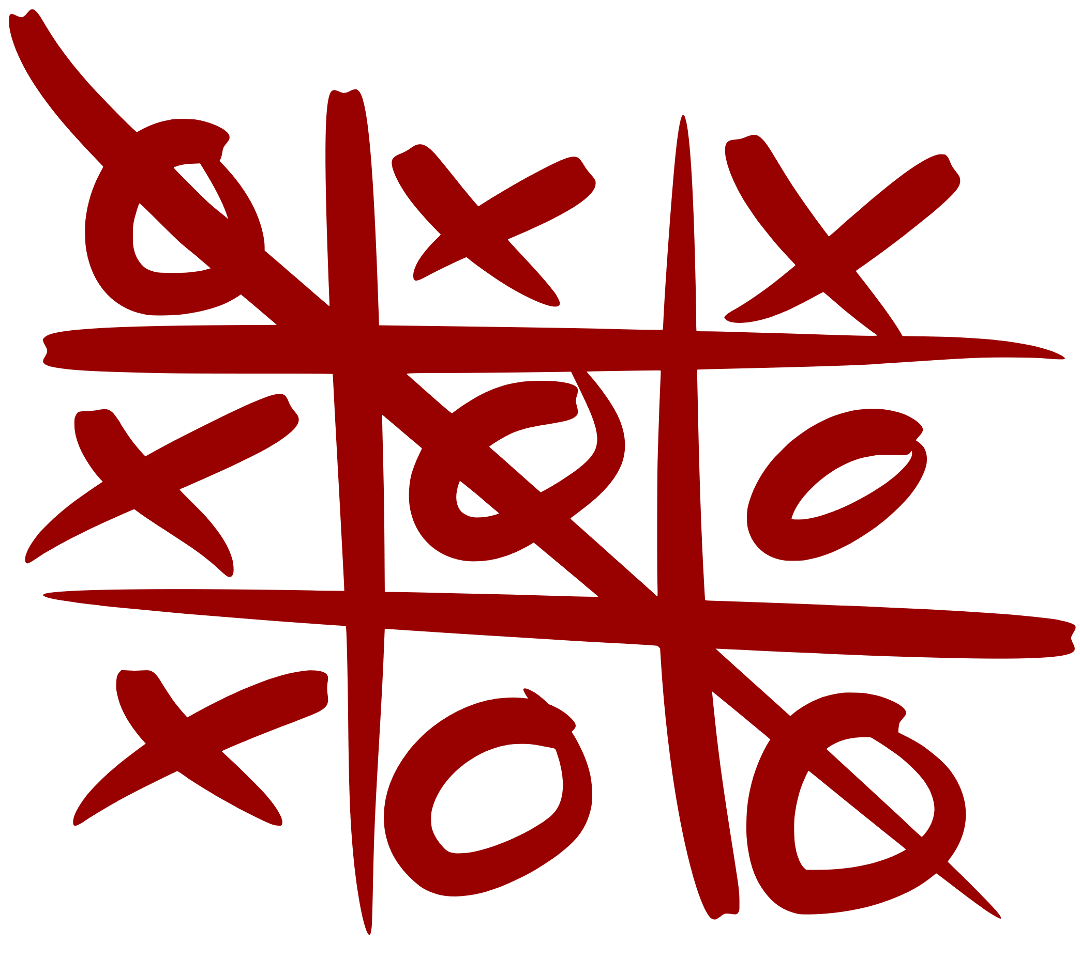
Tic-Tac-Toe AI Using Minimax Algorithm and Alpha-Beta Pruning for Optimal Decision-Making
Tic-Tac-Toe AI
Group 01
Miwan Sariana Saquib – 2131200042 Md. Mubtasim Fuad Arnob – 2022122042 Redwan Hossain – 2121025642 Md. Naimul Hasan Munna – 2122119642
CSE440
Section 1
Supervisor:
Mohammad Shifat-E-Rabbi (MSRb)

Slide 2
Introduction
Objective: The goal is to develop and optimal Tic-Tac-Toe AI.
Key Features:
It makes optimal moves using the Minimax algorithm.
Efficiency is achieved through Alpha-Beta Pruning.
A heuristic evaluation system allows for fast, limited-depth play.
The AI's primary directive is to always win or draw, ensuring it's never defeated.

Slide 3
Significance of Tic-Tac-Toe
Simple yet Strategic: The rules are simple, but the game involves complex decision-making.
Ideal for AI Testing: It has a small number of possible states and clear outcomes.
Turn-Based: The structure is perfect for algorithms like Minimax and Alpha-Beta Pruning.
Easy to Measure: Performance is clearly defined as a win, loss, or draw.

Slide 4


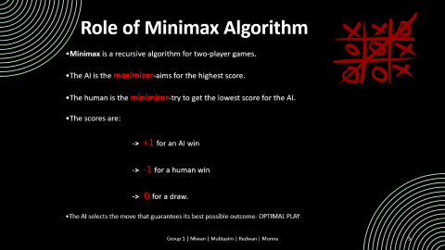
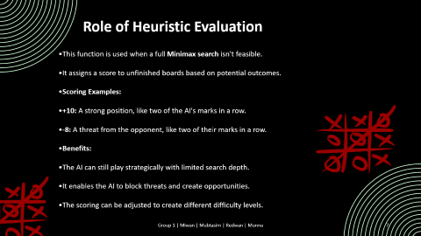




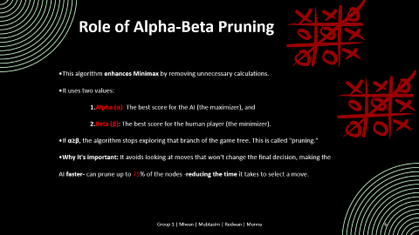

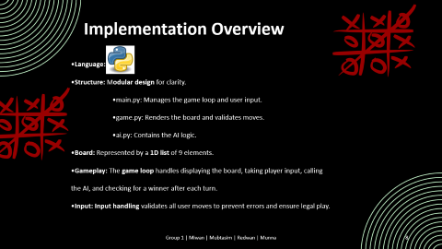
Methodology

Slide 5
Role of Minimax Algorithm
Minimax is a recursive algorithm for two-player games.
The AI is the maximizer-aims for the highest score.
The human is the minimizer-try to get the lowest score for the AI.
The scores are: -> +1 for an AI win -> -1 for a human win -> 0 for a draw.
The AI selects the move that guarantees its best possible outcome- OPTIMAL PLAY

Slide 6
Role of Alpha-Beta Pruning
This algorithm enhances Minimax by removing unnecessary calculations.
It uses two values: 1.Alpha (α): The best score for the AI (the maximizer), and 2.Beta (β): The best score for the human player (the minimizer).
If α≥β, the algorithm stops exploring that branch of the game tree. This is called "pruning."
Why it's important: It avoids looking at moves that won't change the final decision, making the AI faster- can prune up to 75% of the nodes -reducing the time it takes to select a move.

Slide 7
Role of Heuristic Evaluation
This function is used when a full Minimax search isn't feasible.
It assigns a score to unfinished boards based on potential outcomes.
Scoring Examples:
+10: A strong position, like two of the AI's marks in a row.
-8: A threat from the opponent, like two of their marks in a row.
Benefits:
The AI can still play strategically with limited search depth.
It enables the AI to block threats and create opportunities.
The scoring can be adjusted to create different difficulty levels.

Slide 8

Implementation Overview
Language: Python.
Structure: Modular design for clarity.
main.py: Manages the game loop and user input.
game.py: Renders the board and validates moves.
ai.py: Contains the AI logic.
Board: Represented by a 1D list of 9 elements.
Gameplay: The game loop handles displaying the board, taking player input, calling the AI, and checking for a winner after each turn.
Input: Input handling validates all user moves to prevent errors and ensure legal play.

Slide 9
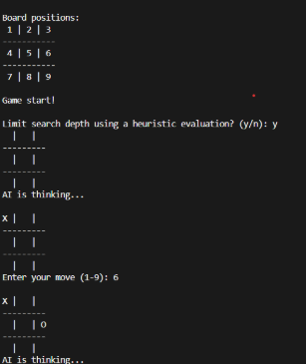
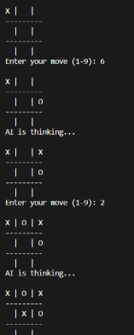
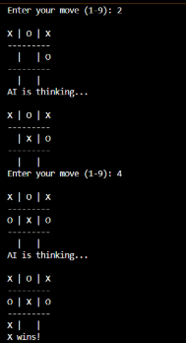
OUTPUT OF TIC TAC TOE

Slide 10
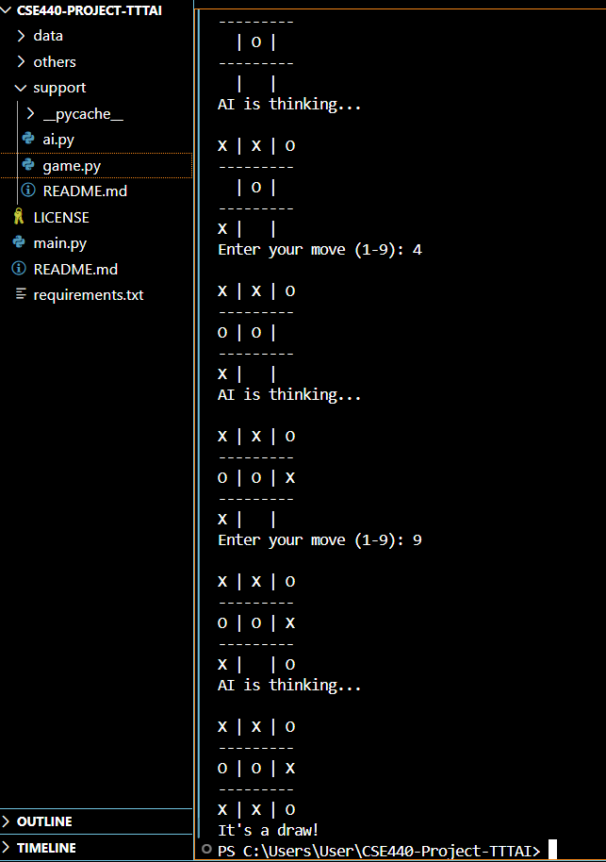
Outcomes
The AI never lost when using full-depth Minimax.
It consistently blocked threats and chose winning moves.
The AI would force a draw if a win was not an option.

Slide 11
Performance
Alpha-Beta Pruning Impact
Up to 75% fewer nodes, much faster response
Heuristic Evaluation Results
Mode | Avg. Nodes Evaluated | Time per Move
Minimax (no pruning) | ~5350 | 65–90 ms
Minimax + Pruning | ~1180 | 15–25 ms
Depth Limit | Win Rate vs Random | Behavior
Full (9) | 100% | Always optimal
3 + Heuristic | ~85% | Strong, may miss setups
2 + Heuristic | ~70% | Defensive, blocks threats

Slide 12
Conclusion
The AI, using full-depth Minimax, proved unbeatable.
It consistently blocked threats and took winning moves.
The AI would force a draw when a win was not possible.
Pruning made the AI's response time much faster.
The Heuristic evaluation system allowed for strong play even in situations with limited search.
The modular code made the project easy to test and update.

Slide 13
Drawbacks
No Learning: The AI doesn't learn or improve on its own.
Fixed Board Size: It only works for a standard 3x3 grid and can't scale to larger boards.
No GUI: The game is text-based, lacking a graphical interface.
Static Behavior: The AI plays perfectly every time, offering no difficulty variation without manual adjustments.
Limited Challenge: The perfect play can become predictable for experienced players.

Slide 14
Future Plan
Add a GUI: Use frameworks like Tkinter or Pygame to create a visual interface for click-based gameplay and highlighting of moves.
AI Learning & Adaptation: Implement Q-learning or Reinforcement Learning to enable the AI to learn from its past games and improve its strategy over time.
Support Larger Boards: Extend the game to support larger grids like 4x4 or 5x5 to Optimize the Minimax algorithm using techniques like Iterative Deepening or Monte Carlo Tree Search.
Performance Profiling: Use tools like cProfile to analyze the code, find bottlenecks, and optimize the AI's performance.

Slide 15
Thank you

